Slide 1
新型學習演算法
111356047 黃名儀
111356048 汪妤

Slide 2
Contents
01
02
03
04
05
06
Datasets
Model structure
Hyperparameter
Algorithm
Results
Conclusion

Slide 3
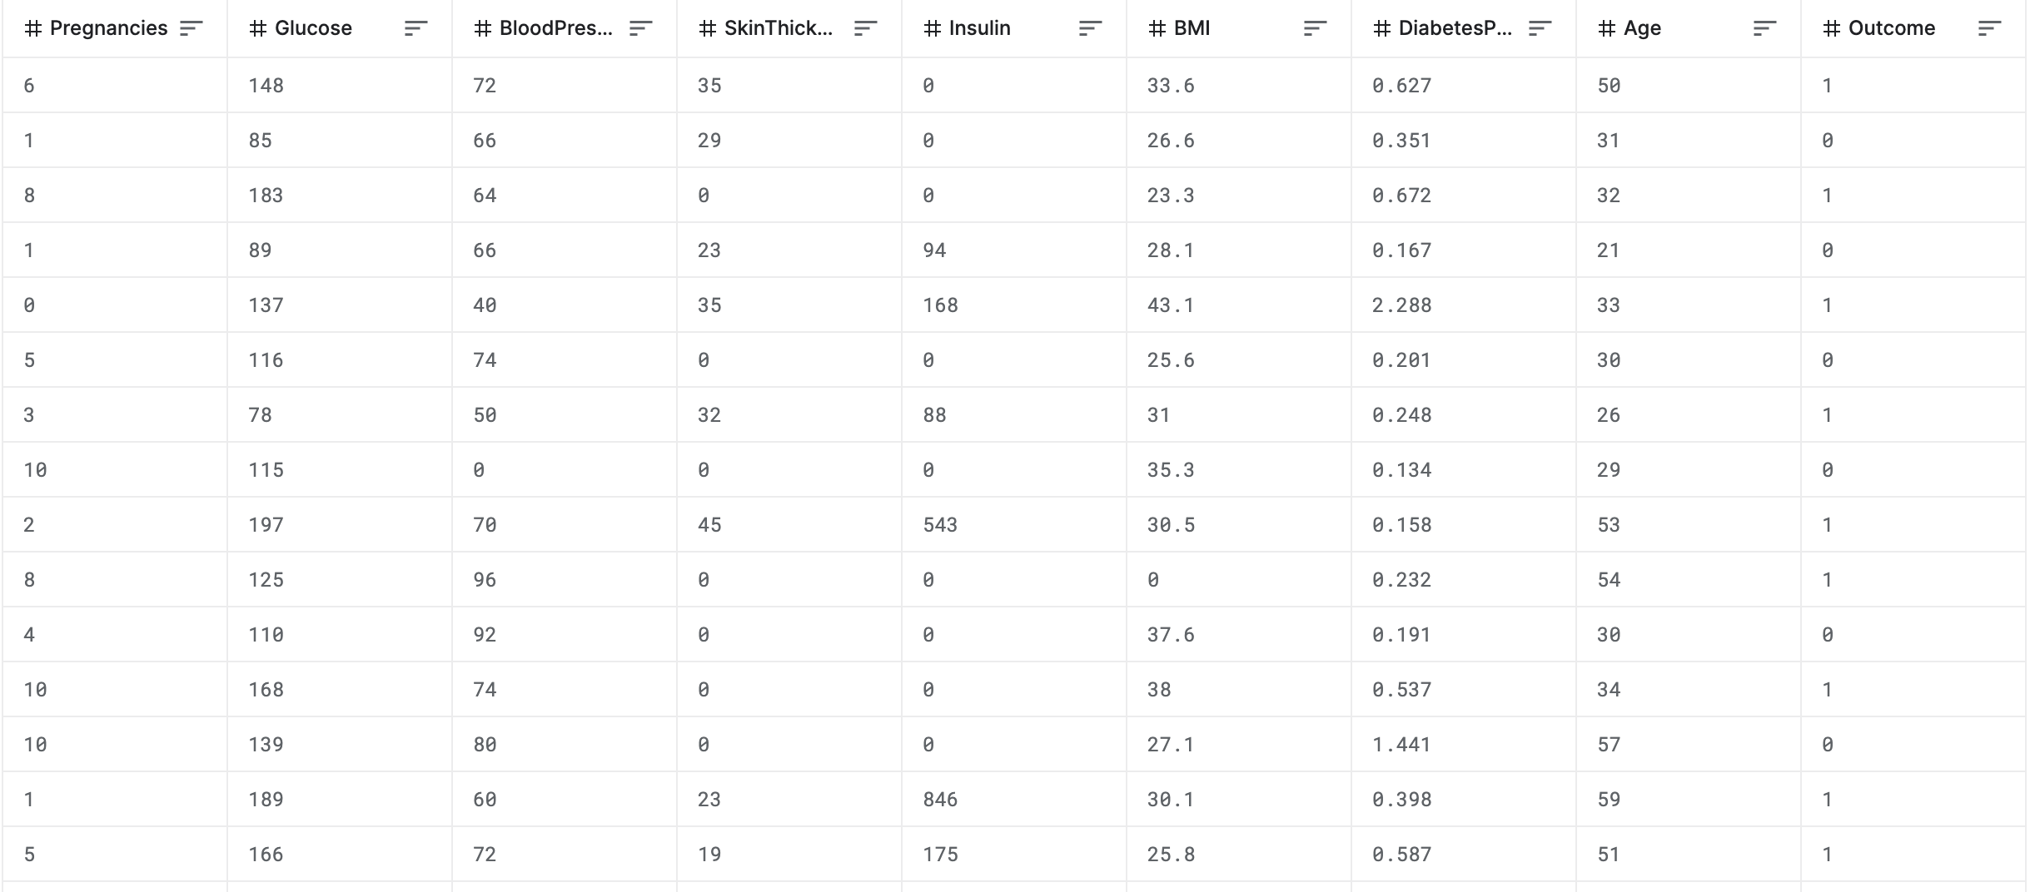
Dataset

Slide 4
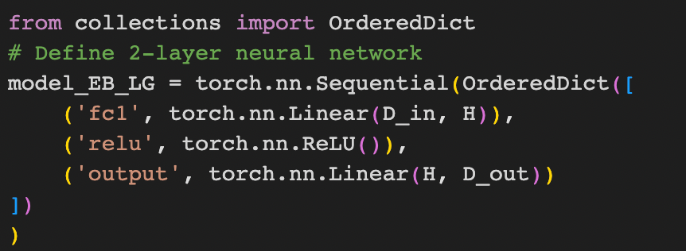
Model structure

Slide 5
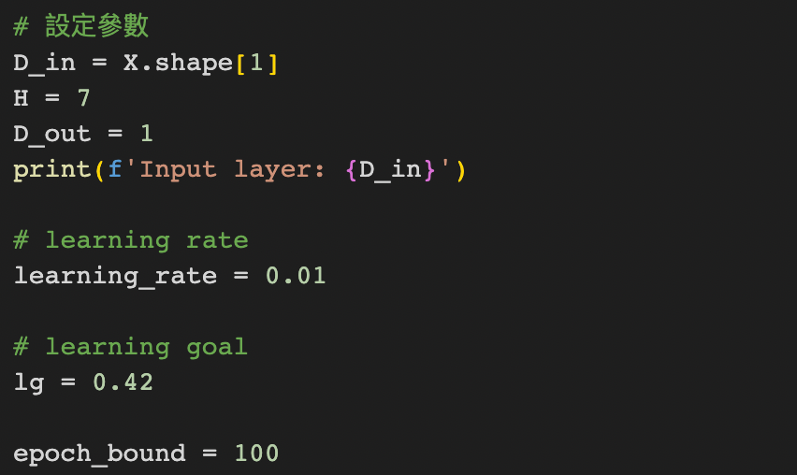
Hyperparameter setting

Slide 6
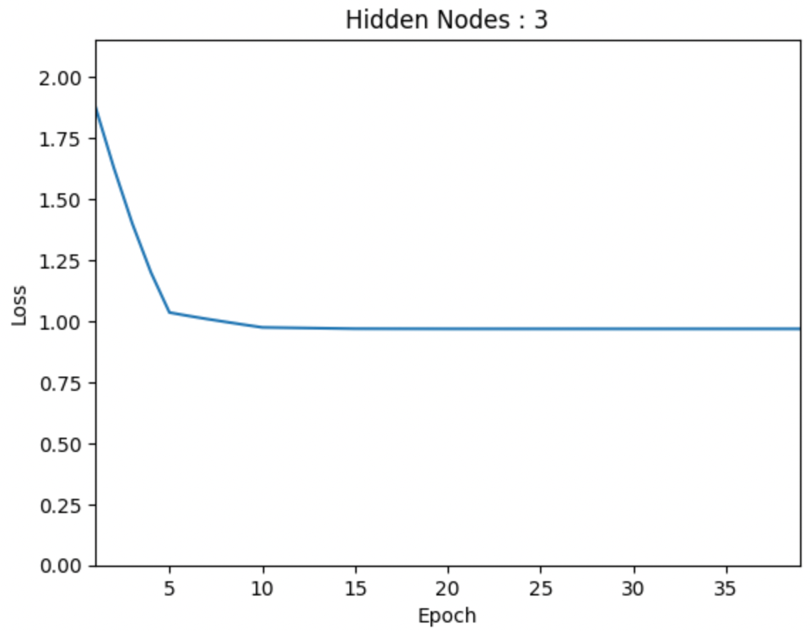
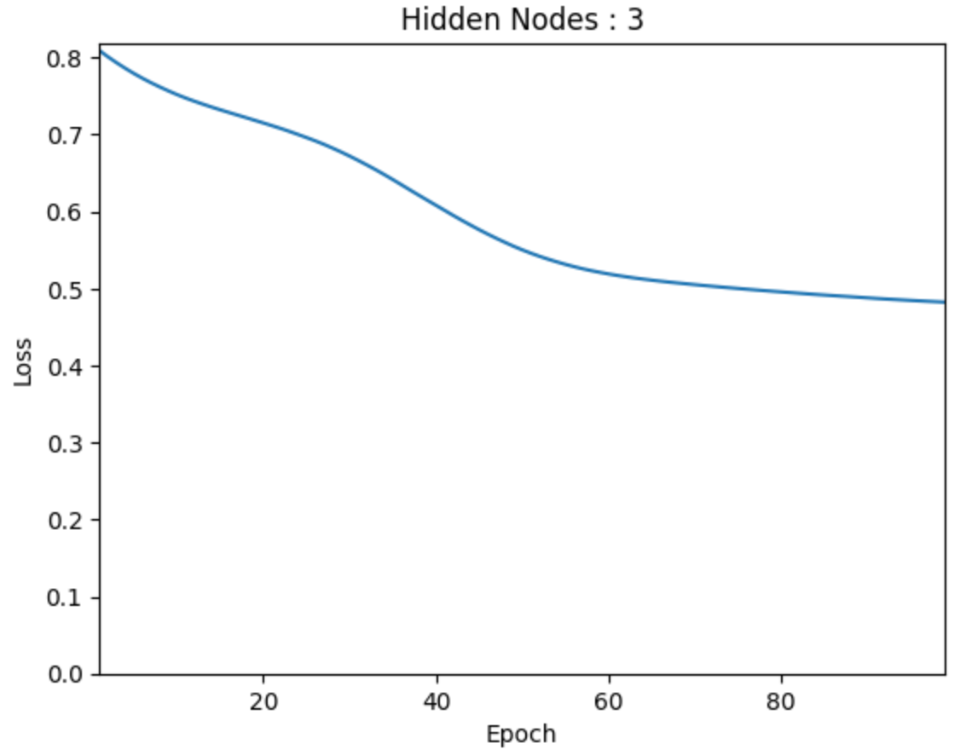
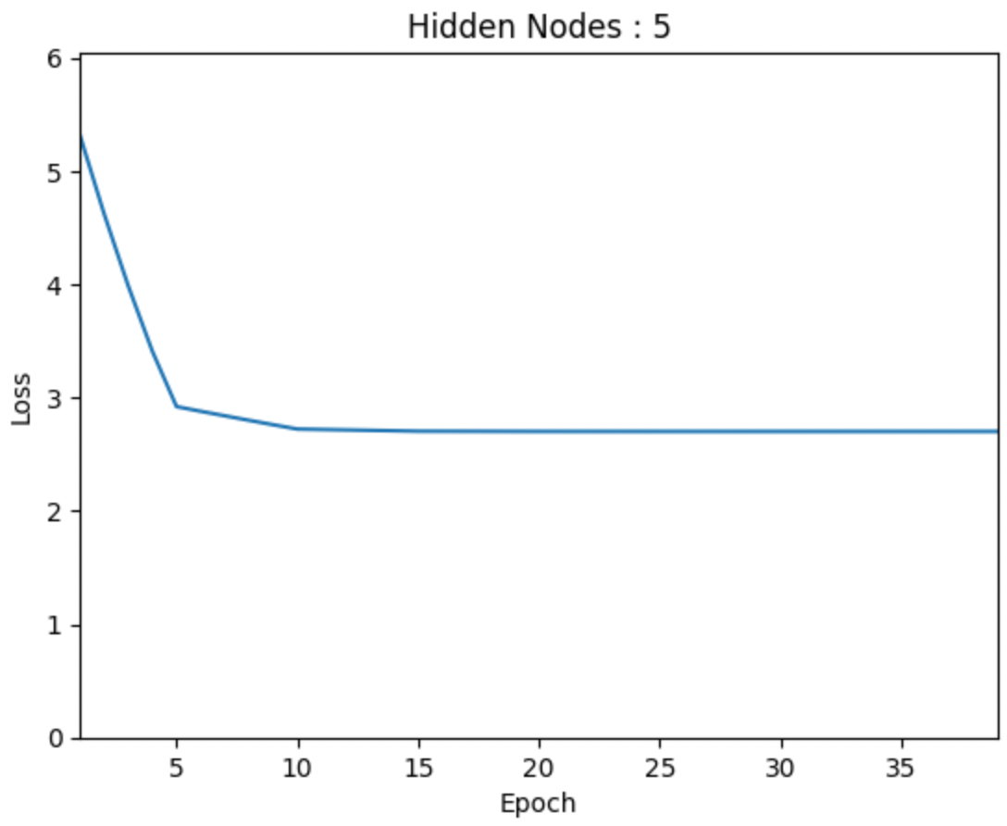
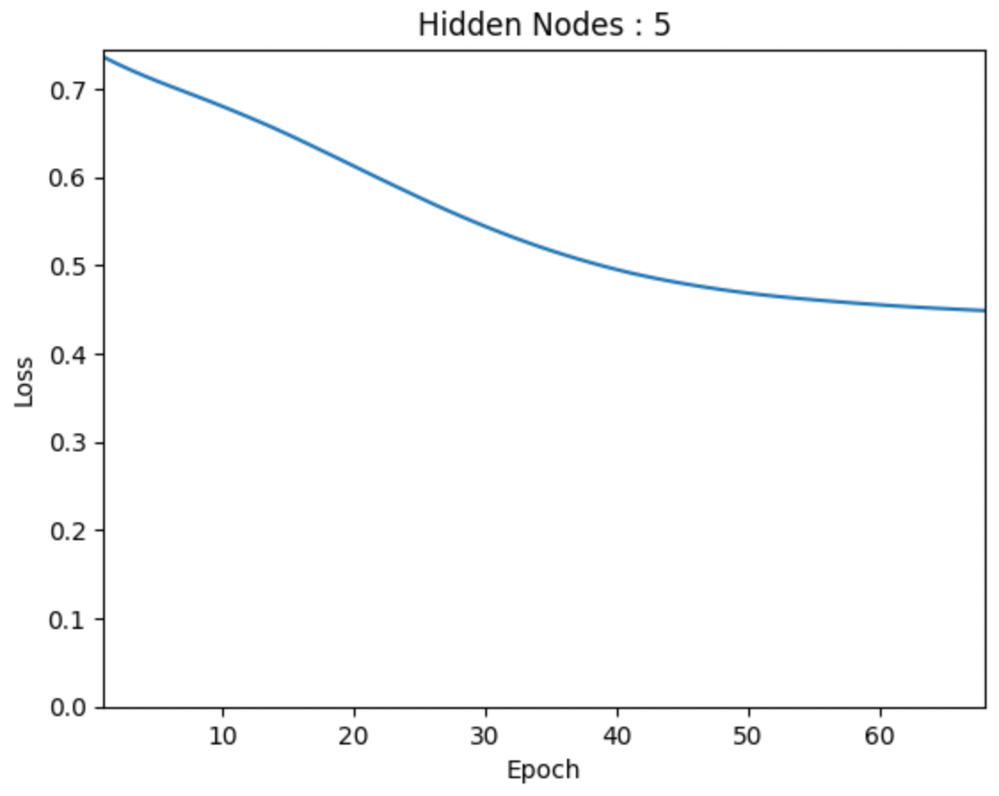

Slide 7
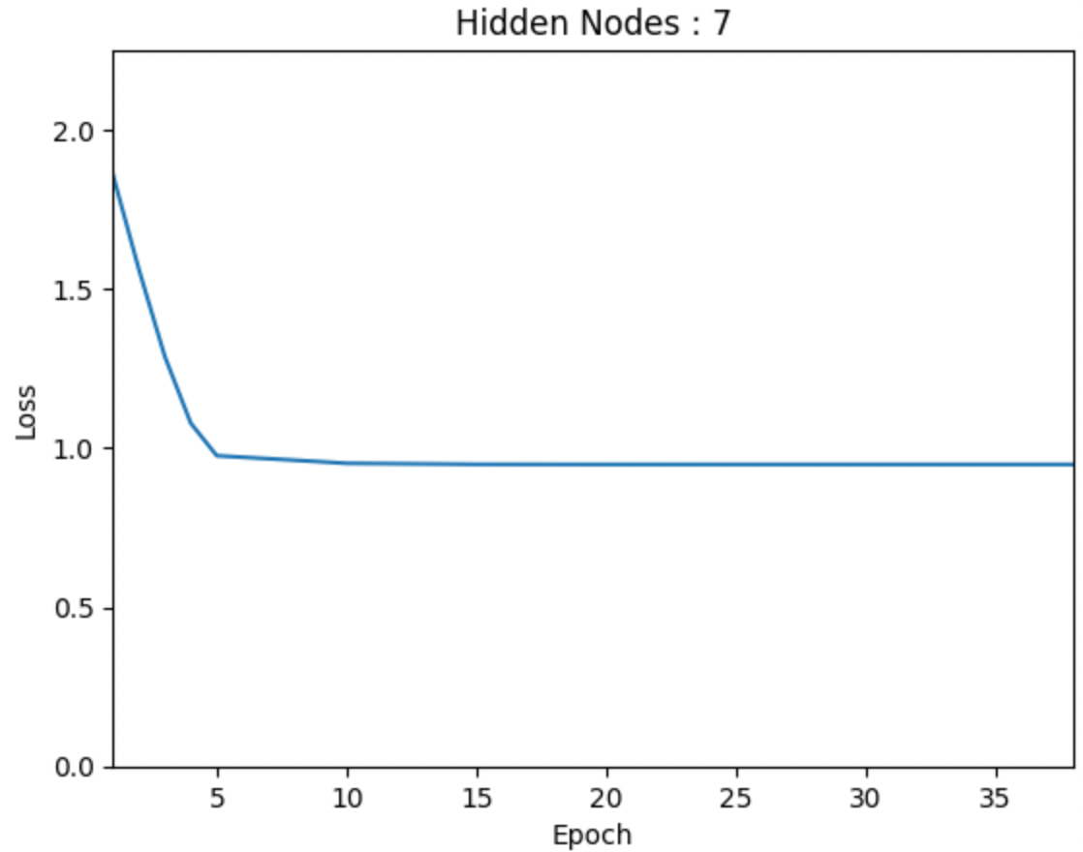
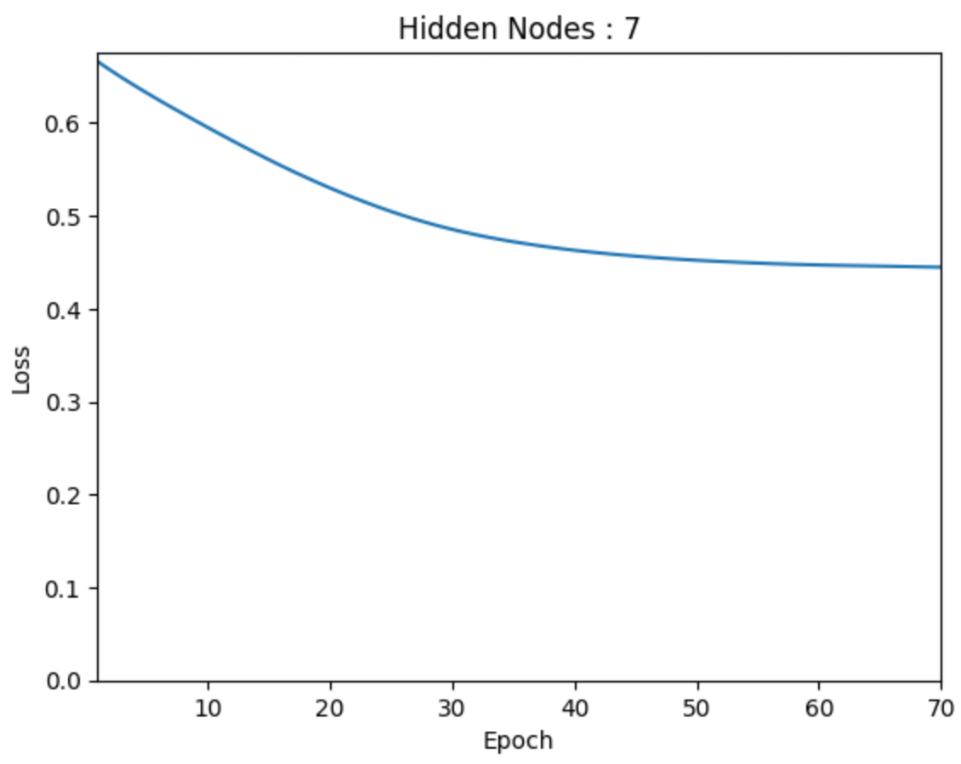
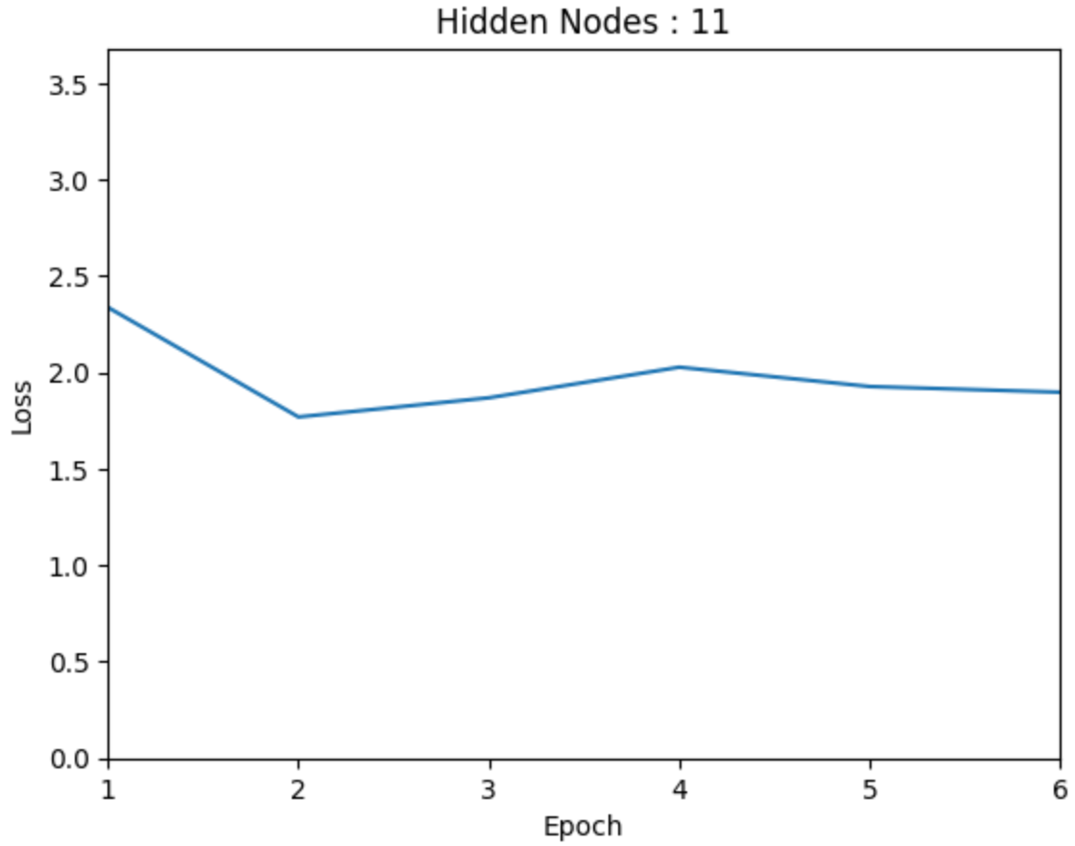
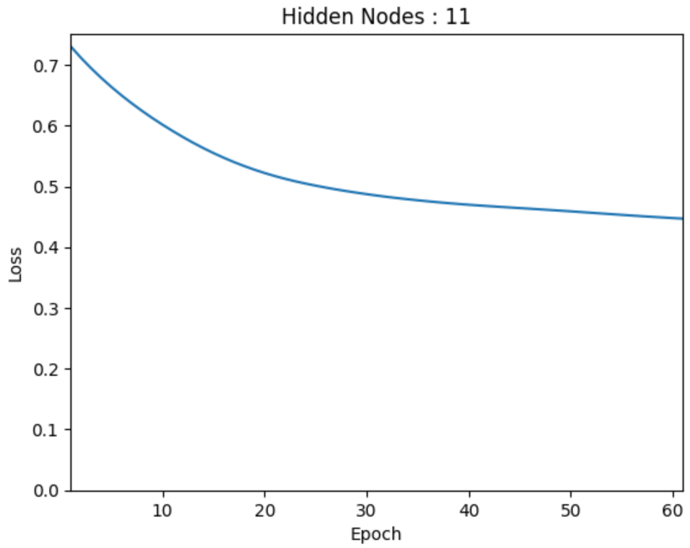

Slide 8
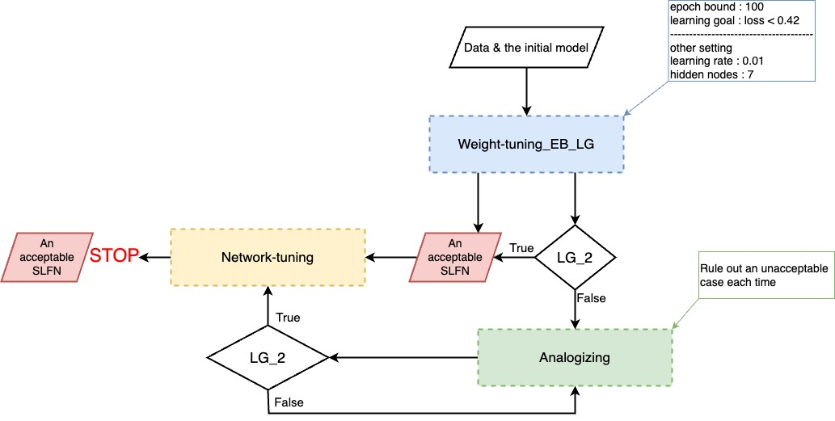
Algorithm

Slide 9
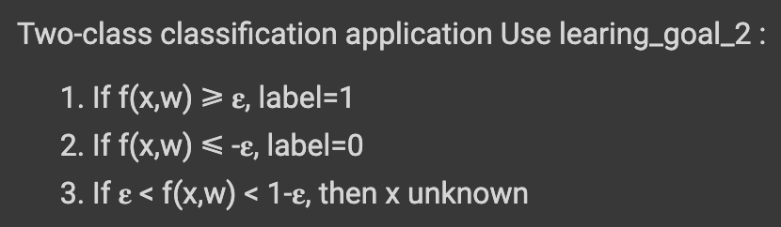
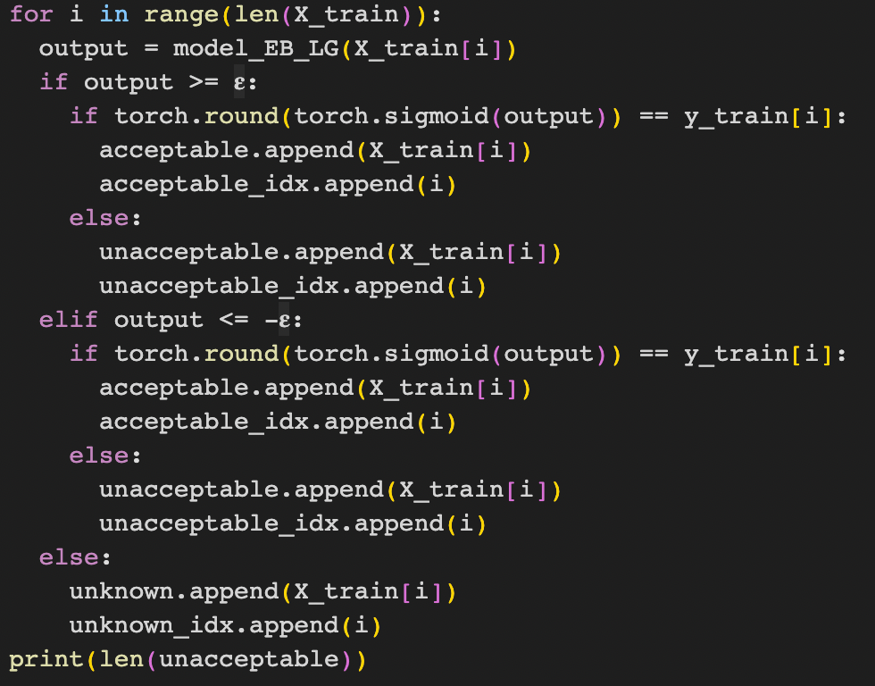
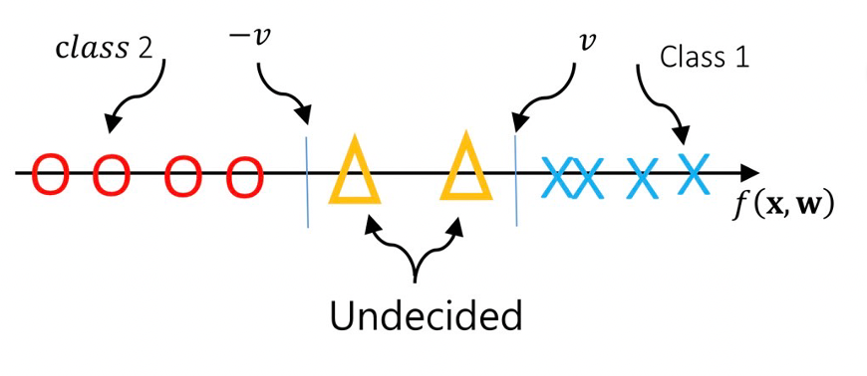
Learning Goal_2

Slide 10
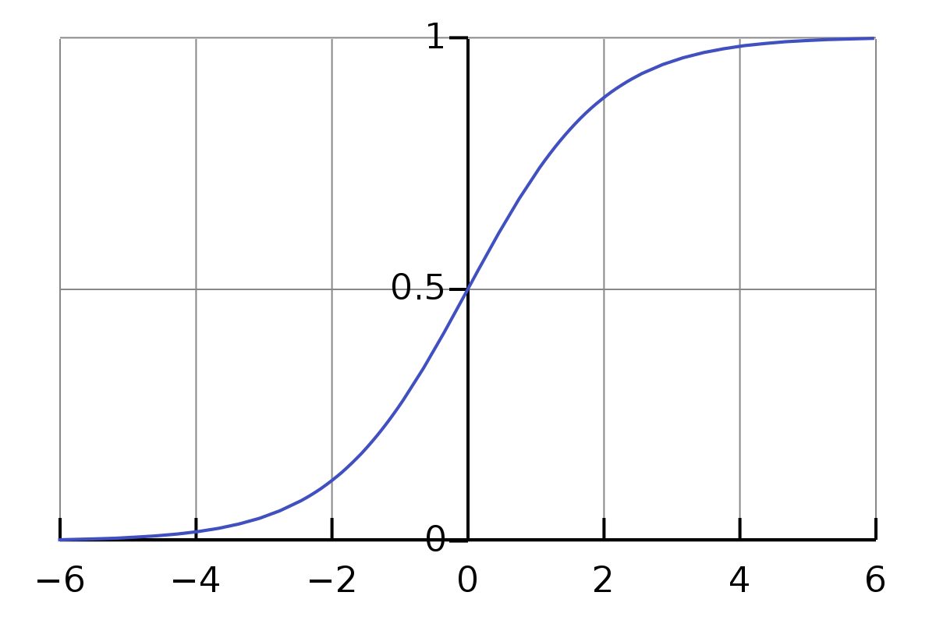
Sigmoid
-𝛆
𝛆

Slide 11
Results

Slide 12
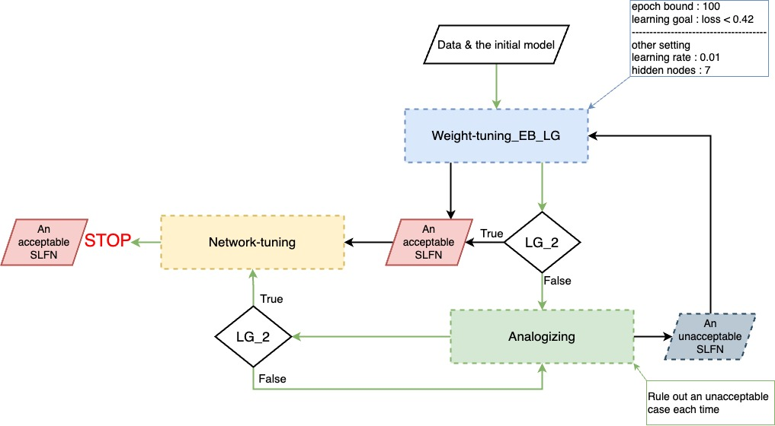
Green path

Slide 13
Unacceptable cases (𝛆 = 2.5) | Analogizing (hidden nodes) | Loss<0.42 | Test Accuracy | Network-tuning (hidden nodes) | Test Accuracy
4 | 19 | no | 74.68% | 15 | 61.04%
3 | 16 | no | 72.73% | 8 | 61.69%
1 | 10 | no | 77.27% | 2 | 66.83%
4 | 19 | no | 76.62% | 15 | 80.52%
2 | 13 | no | 74.68% | 8 | 59.74%
1 | 10 | no | 81.17% | 4 | 64.94%
4 | 19 | no | 77.27% | 15 | 76.62%
4 | 19 | no | 73.38% | 14 | 70.13%
2 | 13 | no | 74.03% | 8 | 75.97%
2 | 13 | no | 74.03% | 8 | 70.78%
Average | 15.1 | X | 75.586% | 9.7 | 68.826%

Slide 14
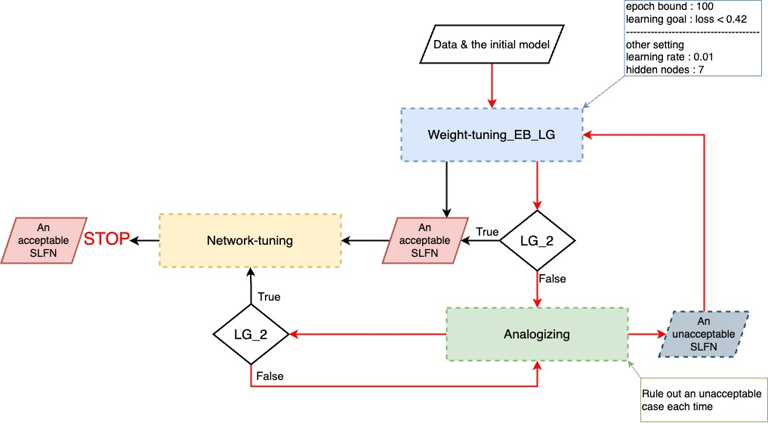
Red path

Slide 15
Unacceptable cases (𝛆 = 2) | Analogizing (hidden nodes) | Loss<0.42 | Test Accuracy | Network-tuning (hidden nodes) | Test Accuracy
8 | 31 | no | 74.03% | 25 | 67.53%
6 | 28 | no | 79.87% | 23 | 77.27%
8 | 31 | no | 75.97% | 26 | 67.53%
4 | 19 | no | 77.27% | 26 | 73.38%
7 | Fail | Nan | 79.87% | Nan | Nan
7 | 25 | no | 70.13% | 20 | 57.14%
6 | Fail | Nan | 75.97% | Nan | Nan
9 | Fail | Nan | 74.03% | Nan | Nan
6 | 25 | no | 74.68% | 20 | 58.44%
7 | Fail | Nan | 70.13% | Nan | Nan
Average | 26.5 | X | 75.195% | 23.3 | 66.88%

Slide 16
Thank you

